Slide 1
“THEORY OF AUTOMATA”
Transition Graph

Slide 2
Summary
Language of strings beginning with and ending in different letters,
Accepting all strings, accepting nonempty strings, accepting no string,
Containing double a’s, having double 0’s or double 1’s,
Containing triple a’s or triple b’s, EVEN-EVEN
FA corresponding to finite languages(using both methods),
Transition graphs

Slide 3
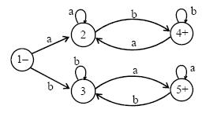
Example
Consider the Language L of Strings, defined over Σ = {a, b}, beginning with and ending in different letters.
The language L may be expressed by the following regular expression a(a + b)*b + b(a + b)*a
This language may be accepted by the following FA

Slide 4


Example
Consider the Language L, defined over Σ = {a, b} of all strings including A. The language L may be accepted by the following FA
The language L may also be accepted by the following FA
The language L may be expressed by the regular expression (a + b)*

Slide 5

Example
Consider the Language L , defined over Σ = {a, b} of all non empty strings. The language L may be accepted by the following FA
The above language may be expressed by the regular expression (a + b)⁺

Slide 6

Example
Consider the following FA, defined over Σ = {a, b}
It is to be noted that the above FA does not accept any string, even it does not accept the null string; as there is no path starting from initial state and ending in final state.

Slide 7

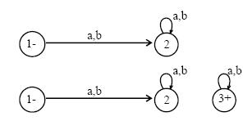
Equivalent FAs
It is to be noted that two FAs are said to be equivalent, if they accept the same language, as shown in the following FAs.
FA₁
FA₂
FA₃

Slide 8
Note
FA1 has already been discussed, while in FA2, there is no final state and in FA3, there is a final state but FA3 is disconnected as the states 2 and 3 are disconnected.
It may also be noted that the language of strings accepted by FA1, FA2 and FA3 is denoted by the empty set i.e. { } OR Ø

Slide 9

Example
Consider the Language L of strings , defined over Σ = {a, b}, containing double a. The language L may be expressed by the regular expression (a+b)* (aa) (a+b)*. This language may be accepted by the following FA.

Slide 10
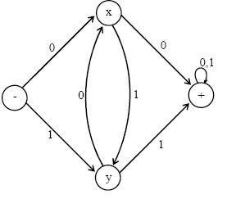
Example
Consider the language L of strings, defined over Σ={0, 1}, having double 0’s or double 1’s, The language L may be expressed by the regular expression (0+1)* (00 + 11) (0+1)* This language may be accepted by the following FA

Slide 11
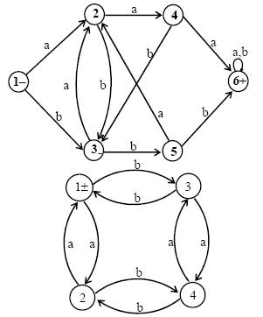
Example
Consider the language L of strings, defined over Σ={a, b}, having triple a’s or triple b’s. The language L may be expressed by RE (a+b)* (aaa + bbb) (a+b)*
This language may be accepted
by the FA as shown aside

Slide 12
Example
Consider the EVEN-EVEN language, defined over Σ = {a, b}. As discussed earlier that EVEN-EVEN language can be expressed by the regular expression (aa+bb+(ab+ba)(aa+bb)*(ab+ba))*
EVEN-EVEN language may be accepted by the FA as shown aside

Slide 13
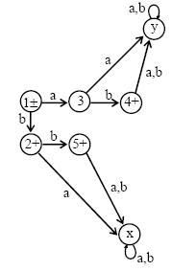
FA corresponding to finite languages
Example
Consider the language
L = {A, b, ab, bb}, defined over Σ ={a, b},
expressed by Λ + b + ab + bb OR Λ + b (Λ + a + b).
The language L may be accepted by the FA as shown aside
It is to be noted that the states x and y are called
Dead States, Waste Baskets or Davey John Lockers,
as the moment one enters these states
there is no way to leave it.

Slide 14
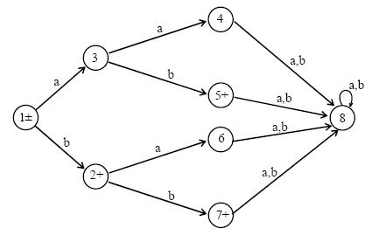
Note
It is to be noted that to build an FA accepting the language having less number of strings, the tree structure may also help in this regard, which can be observed in the following transition diagram for the Language L, discussed in the above example

Slide 15
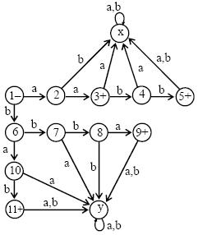
Example
Consider the language
L = {aa, bab, aabb, bbba}, defined over Σ ={a, b},
expressed by aa + bab + aabb + bbba OR aa (Λ + bb) + b (ab + bba)
The above language may be accepted by the FA as shown aside

Slide 16
Transition Graph
Definition :
A Transition graph (TG), is a collection of the followings
  Finite number of states, at least one of which is start state and some (maybe none) final states.
  Finite set of input letters (Σ) from which input strings are formed.
  Finite set of transitions that show how to go from one state to another based on reading specified substrings of input letters, possibly even the null string (Λ)
Note
It is to be noted that in TG there may exist more than one paths for certain string, while there may not exist any path for certain string as well. If there exists at least one path for a certain string, starting from initial state and ending in a final state, the string is supposed to be accepted by the TG, otherwise the string Is supposed to be rejected. Obviously collection of accepted strings is the language accepted by the TG.

Slide 17

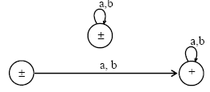
Example
Consider the Language L , defined over Σ = {a, b} of all strings including Λ. The language L may be accepted by the following TG
The language L may also be accepted by the following TG
TG₁
TG₂

Slide 18
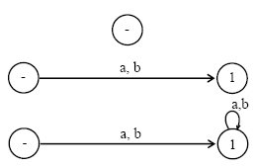
Example
Consider the following TGs
TG₁
TG₂
TG₃
It may be observed that in the first TG, no transition has been shown. Hence this TG does not accept any string, defined over any alphabet. In TG2 there are transitions for a and b at initial state but there is no transition at state 1. This TG still does not accept any string. In TG3 there are transitions at both initial state and state 1, but it does not accept any string.

Slide 19

Example
Consider the language L of strings, defined over Σ={a, b}, starting with b. The language L may be expressed by RE b(a + b)* , may be accepted by the following TG

Slide 20
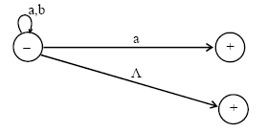
Example
Consider the language L of strings, defined over Σ={a, b}, not ending in b. The language L may be expressed by RE Λ + (a + b)*a , may be accepted by the following TG

Slide 21

Example
Consider the Language L of strings, defined over Σ = {a, b}, containing double a. The language L may be expressed by the following regular expression (a+b)* (aa) (a+b)*. This language may be accepted by the following TG

Slide 22
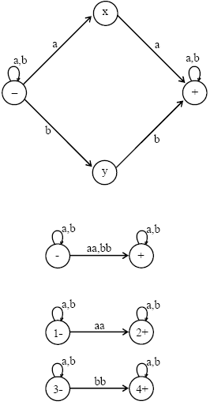
Example
Consider the language L of strings, defined over Σ={a, b}, having double a or double b. The language L can be expressed by RE (a+b)* (aa + bb) (a+b)*. The above language may also be expressed by the following TGs
OR
OR

Slide 23
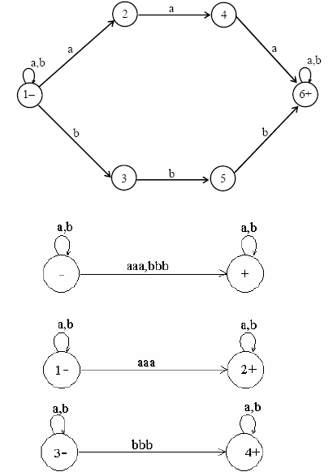
Example
Consider the language L of strings, defined over Σ = {a, b}, having triple a or triple b. The language L may be expressed by RE (a+b)* (aaa + bbb) (a+b)* This language may be accepted by the following TG
OR
OR

Slide 24
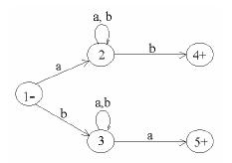
Example
Consider the language L of strings, defined over Σ = {a, b}, beginning and ending in different letters. The language L may be expressed by RE a(a + b)*b + b(a + b)*a The language L may be accepted by the following TG

Slide 25
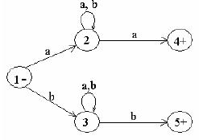
Example
Consider the Language L of strings of length two or more, defined over Σ = {a, b}, beginning with and ending in same letters.
The language L may be expressed by the following regular expression a(a + b)*a + b(a + b)*b This language may be accepted by the following TG

Slide 26

Example
Consider the EVEN-EVEN language, defined over Σ = {a, b}. As discussed earlier that EVEN-EVEN language can be expressed by a regular expression (aa+bb+(ab+ba)(aa+bb)*(ab+ba))* The language EVEN-EVEN may be accepted by the following TG

Slide 27

Example
Consider the language L, defined over Σ={a, b}, in which a’s occur only in even clumps and that ends in three or more b’s. The language L can be expressed by its regular expression (aa)*b(b*+(aa(aa)*b)*) bb OR (aa)*b(b*+( (aa)+b)*) bb.
The language L may be accepted by the following TG

Slide 28
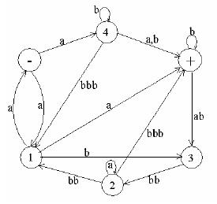
Example
  Consider the following TG
  Consider the string abbbabbbabba. It may be observed
that the above string traces the following three paths,(using the states)
    (a)(b) (b) (b) (ab) (bb) (a) (bb) (a)
    (-)(4)(4)(+)(+)(3)(2)(2)(1)(+)
    (a)(b) ((b)(b)) (ab) (bb) (a) (bb) (a)
    (-)(4)(+)(+)(+)(3)(2)(2)(1)(+)
    (a)((b) (b)) (b) (ab) (bb) (a) (bb) (a)
    (-) (4)(4)(4)(+) (3)(2)(2)(1)(+)
  Which shows that all these paths are successful, (i.e. the path starting from an initial state and ending in a final state).
  Hence the string abbbabbbabba is accepted by the given TG.

Slide 29
Generalized Transition Graphs
A generalized transition graph (GTG) is a collection of three things
Finite number of states, at least one of which is start state and some (maybe none) final states.
Finite set of input letters (G) from which input strings are formed.
Directed edges connecting some pair of states labeled with regular expression.
It may be noted that in GTG, the labels of transition edges are corresponding regular expressions

Slide 30
LINK
www.eecs.berkeley.edu/~newton/Classes/CS150sp97/lectures/week1_1/tsld026.htm
www.santafe.edu/~hag/complex2/node2.html

